Slide 1
Driverless Vehicles.
Effects on Traffic Flow & Accident Rates.
Alex Molodyh
Michael Brown

Slide 2
(Revised) Vision Statement
For people who want to see how artificial intelligence should decrease the rate of traffic accidents in the United States, the AI Traffic Model is a model that will provide such information regarding human and self-driven cars. The model will use data based on traffic accidents caused by humans while driving in various conditions such as driving under the influence of substances, using mobile devices, fatigue, road rage, and human error. Unlike current models about traffic, our model will include predictive data about artificial intelligence’s effect on traffic.

Slide 3
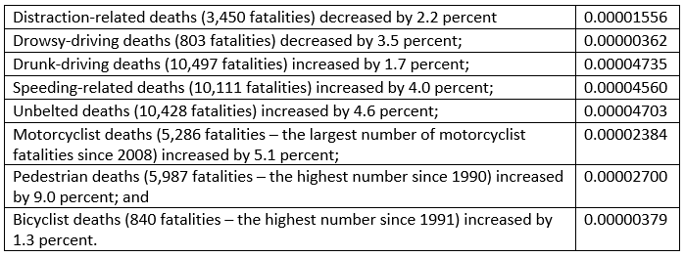
Total drivers in US: 221,712,000
Types of deaths caused by accidents:
Types of Accident Data

Slide 4
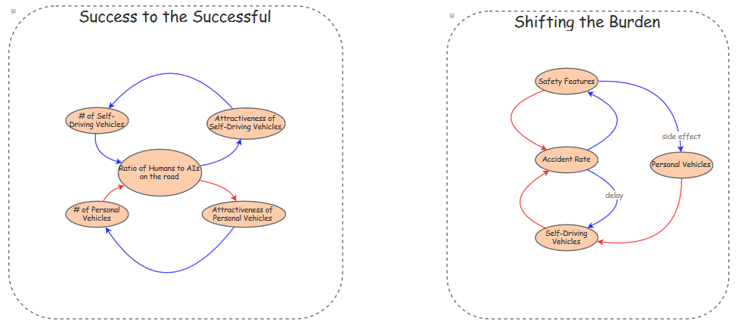
Minimalistic Models

Slide 5
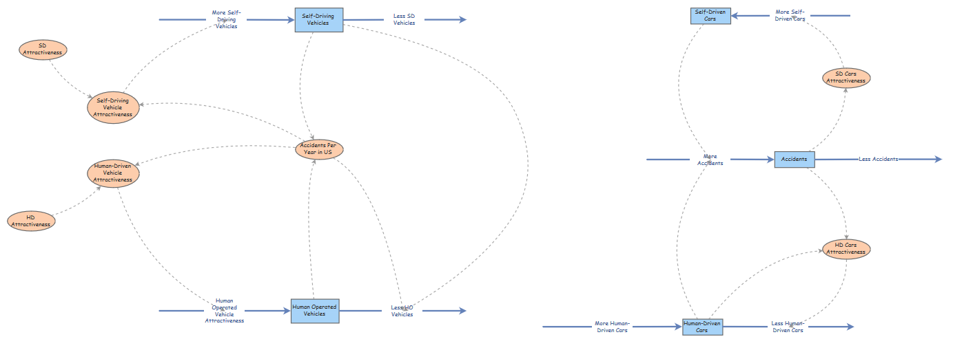
Alpha Model Prototype

Slide 6
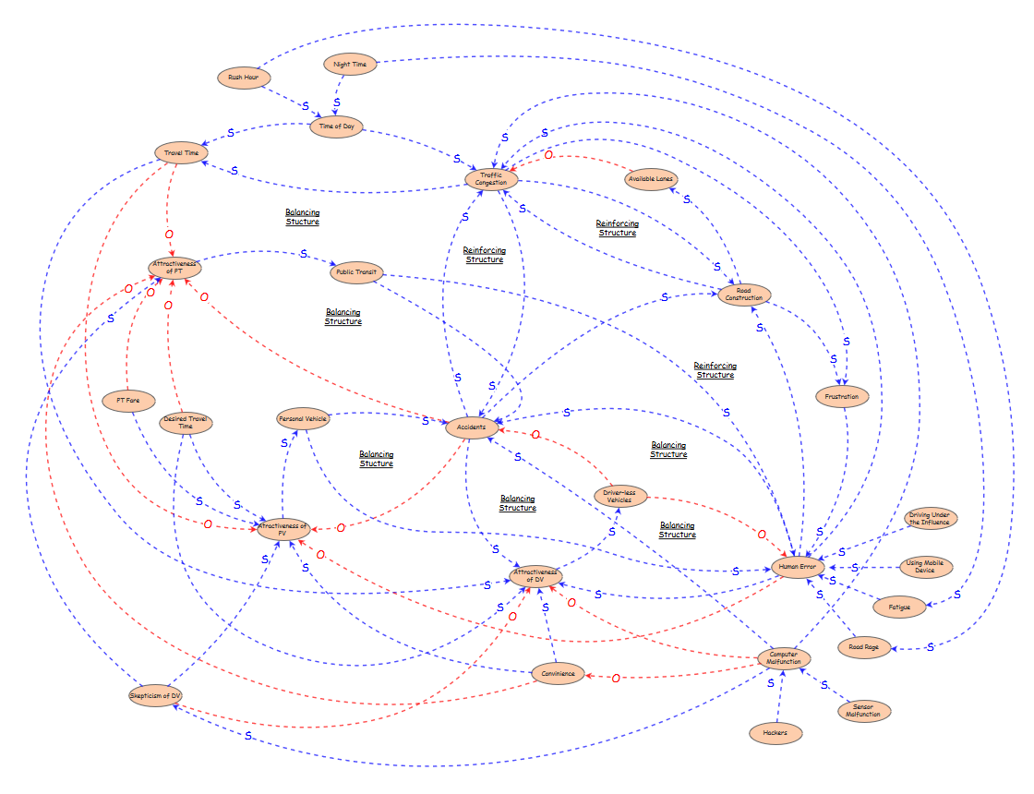
Detailed Causal Loop

Slide 7
References
David Galland, O. G. (2017, 3 3). 10 Million Self-Driving Cars Will Hit The Road By 2020 -- Here's How To Profit. Retrieved from forbes.com: https://www.forbes.com/sites/oliviergarret/2017/03/03/10-million-self-driving-cars-will-hit-the-road-by-2020-heres-how-to-profit/#343802747e50
NHTSA. (2017, 10 6). USDOT Releases 2016 Fatal Traffic Crash Data. Retrieved from nhtsa.gov: https://www.nhtsa.gov/press-releases/usdot-releases-2016-fatal-traffic-crash-data
Statista. (N/A, N/A N/A). Number of licensed drivers in the United States from 1990 to 2016 (in 1,000s). Retrieved from statista.com: https://www.statista.com/statistics/191653/number-of-licensed-drivers-in-the-us-since-1988/
References

